Slide 1

Exploring
#5 Looping

Slide 2
Looping Statements
What ?
Javascript feature that help deal with repeat same / identical work .
Loops can execute a block of code a number of times.
Almost the same with Conditional Statements (if condition), except it will keep executing the code as long as the condition is still true.
Why ?
We don't want to type too much code.
Loops are handy, if you want to run the same code over and over again, each time with a different value.

Slide 3
Different Kinds of Loops
JavaScript supports different kinds of loops:
while
do/while
for

Slide 4
While Loop
The while loop loops through a block of code as long as a specified condition is true.
Syntax :
while (condition) {
// code block to be executed
}

Slide 5
While Loop
var angka = 1;
while(angka <=10){
console.log(angka);
angka++;
}

Slide 6
Do While Loop
The do/while loop is a variant of the while loop. This loop will execute the code block once, before checking if the condition is true, then it will repeat the loop as long as the condition is true.
Syntax :
do {
// code block to be executed
}
while (condition);

Slide 7
Do While Loop
var angka = 1;
do{
console.log(angka);
angka++;
} while(angka <=10) ;

Slide 8
For Loop
The for loop has the following syntax:
for (statement 1; statement 2; statement 3) {
// code block to be executed
}
Statement 1 is executed (one time) before the execution of the code block.
Statement 2 defines the condition for executing the code block.
Statement 3 is executed (every time) after the code block has been executed.

Slide 9
var x;
for(x=1; x<=10; x++){
console.log(x);
}
For Loop

Slide 10
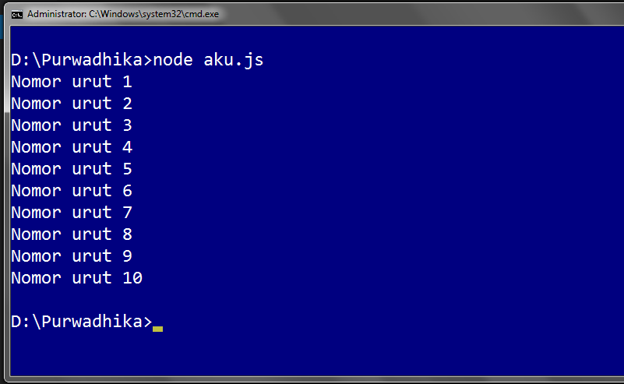
Solve It!

Slide 11
Solved!
var y = 'Nomor urut '; for(let x=1; x<=10; x++){
console.log(y + x);
}

Slide 12
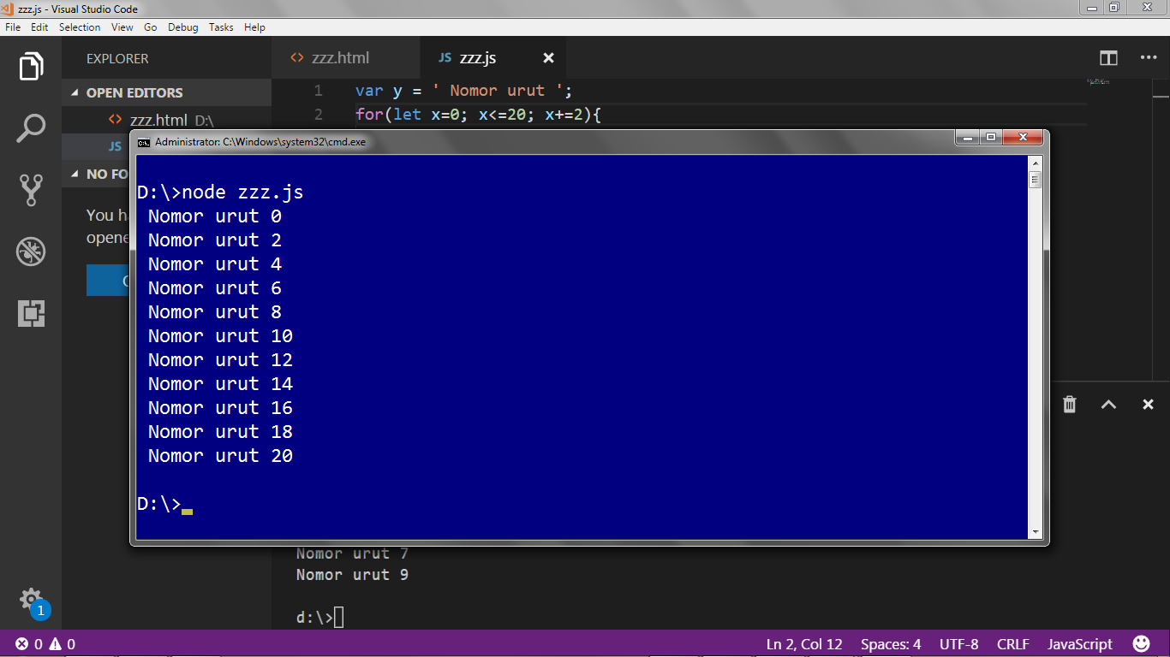
Solve It! #13

Slide 13
Solved!
var y = ' Nomor urut ';
for(let x=0; x<=20; x+=2){
console.log(y + x);
}

Slide 14
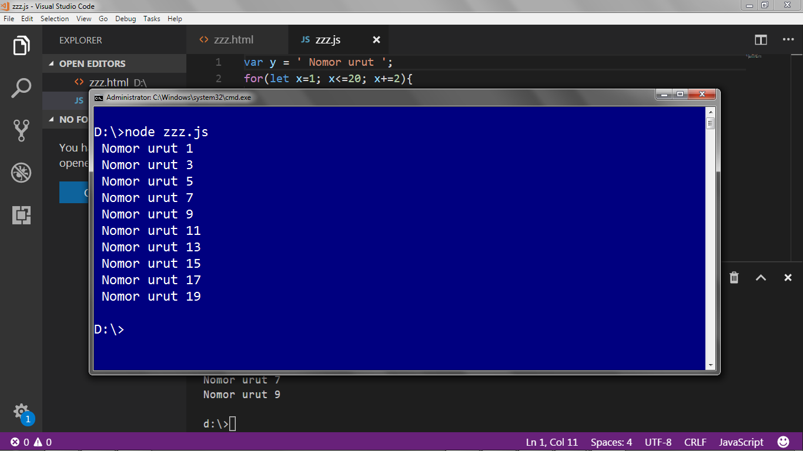
Solve It! #14

Slide 15
Solved!
var y = ' Nomor urut ';
for(let x=1; x<=20; x+=2){
console.log(y + x);
}

Slide 16
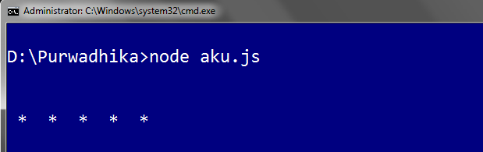
for Loop Drawing
let z='';
for (let i=0;i<5;i++){
z += ' * '
}
console.log(z)

Slide 17
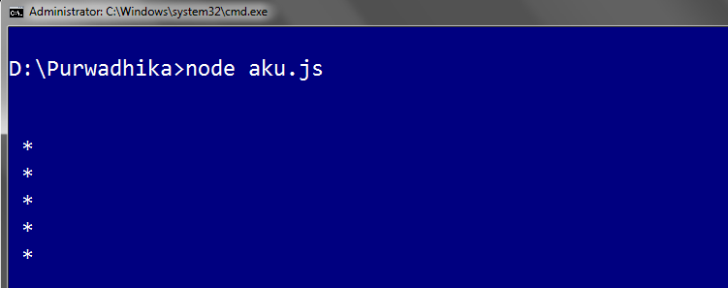
for Loop Drawing
let z=''; for (let i=0;i<5;i++){
z += ' * ' + '\n'
} console.log(z)

Slide 18
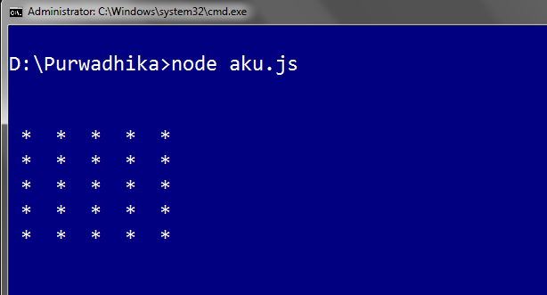
Solve It! #15

Slide 19
for Loop Drawing
let z='';
for (let i=0; i<5; i++){
for (let j=0; j<5 ;j++){
z += ' * '
}
z += '\n'
}
console.log(z)

Slide 20
Learning Resources
https://www.w3schools.com/js/js_loop_for.asp
https://www.w3schools.com/js/js_loop_while.asp
https://www.w3schools.com/js/js_break.asp

Slide 21
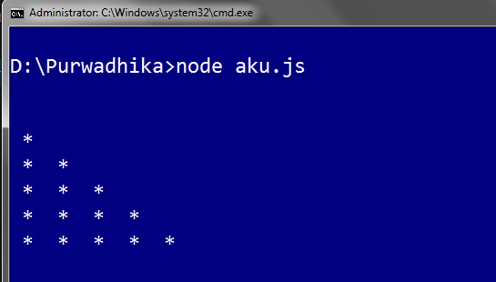
Solve It! #16

Slide 22

Solve It! #17

Slide 23
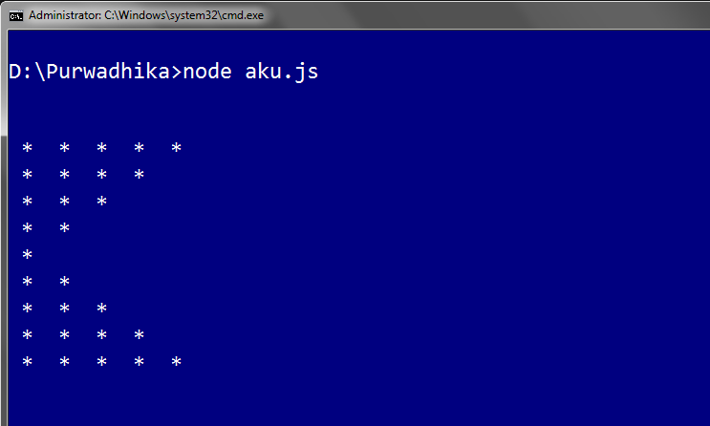
Solve It! #18

Slide 24
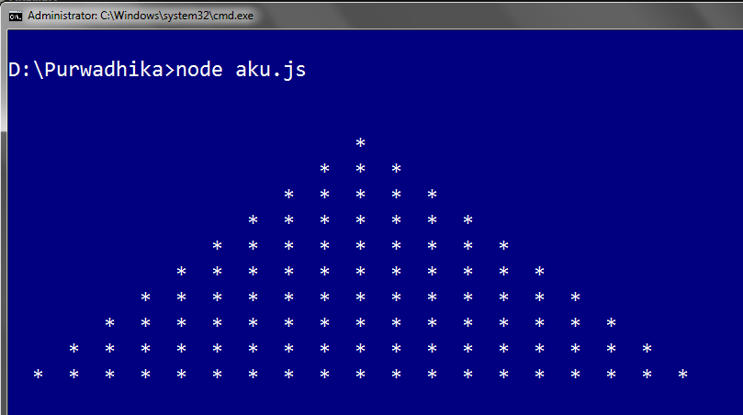
Solve It! #19

Slide 25
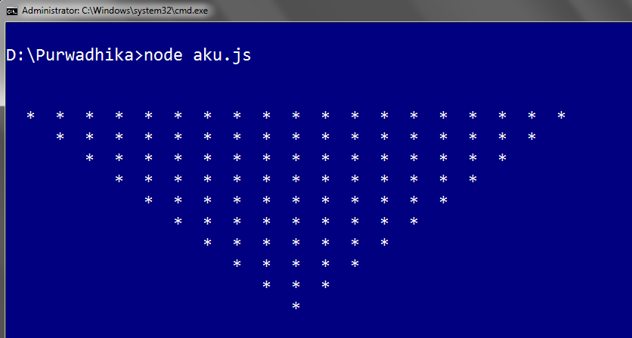
Solve It! #20

Slide 26
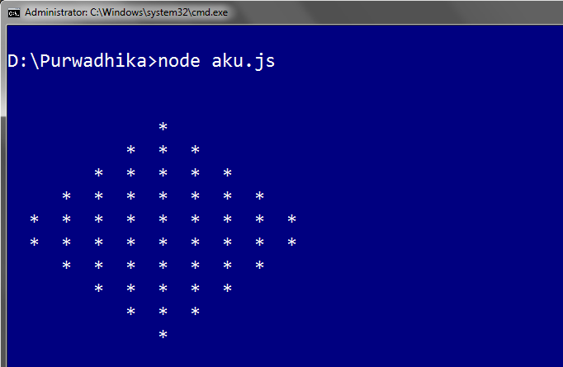
Solve It! #21

Slide 27
Exploring
#5 Looping

